Slide 1




OPERATE AN AUTOMATED INFORMATION SYSTEM
D2.TTA.CL2.14 D2.TGA.CL6.06
Notes:
Trainer introduces themselves and the unit

Slide 2
Subject elements
This unit comprises five Elements:
Identify the context for use of an automated information system
1
Access information using an automated information system
2
Obtain information using an automated information system
3
Use information from information an automated information system
4
Up-date and maintain information on an automated information system
5
Notes:
Trainer advises this Unit comprises five Elements, as listed on the slide explaining:
• Each Element comprises a number of Performance Criteria which will be identified throughout the class and explained in detail
• Trainees can obtain more detail from their Trainee Manual(TM)
• At times the course presents advice and information about various protocols but where their workplace requirements differ to what is presented, the workplace practices and standards, as well as policies and procedures must be observed.
Discuss housekeeping issues such as times of attendance, expected classroom behavior, contact details, any resources required such as a calculator.
Explain that the trainees will be assessed and the requirements of those assessments.

Slide 3
Assessment
Assessment for this unit may include:
Oral questions
Written questions
Work projects
Workplace observation of practical skills
Practical exercises
Formal report from supervisor
Notes:
Trainer advises that assessment for this Unit may take several forms all of which are aimed at verifying they have achieved competency for the Unit as required.
Trainer indicates the methods of assessment that will be applied to them for this Unit.

Slide 4
Element 1: Identify the context for use of an automated information system
1.1 Identify a range of information systems and sources in use within the industry
1.2 Describe policies and procedures for operating an automated information system
1.3 List information that may be available through an automated information system
1.4 Identify the functions of an automated information system
Notes:
Trainer introduces the four performance criteria which make up Element 1

Slide 5

1.1 Identify a range of information systems and sources in use within the industry
Identify different types of automated information systems
CRS (GDS)
Specific company designed systems:
Intranet
Internet
Government tourism bodies
Notes:
Working through the associated pages in the Trainee Manual (TM) have discussion about each topic; types of information sourced. Regularity of use.
(CRS image on next slide)
You may choose for trainees to conduct searches from various systems if they are available to you
Complete Activity 1

Slide 6
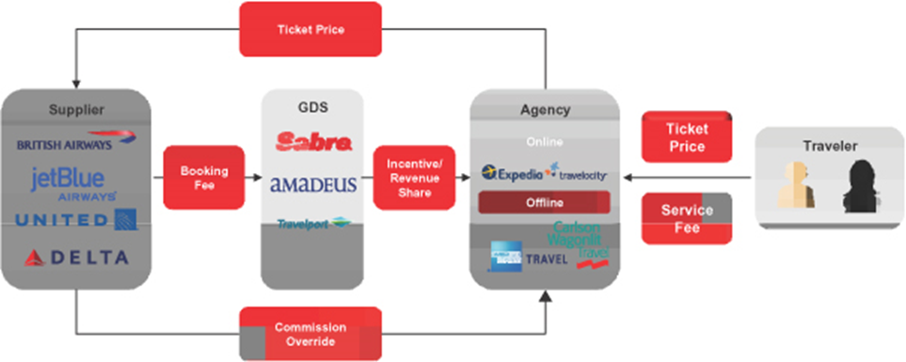
1.1 Identify a range of information systems and sources in use within the industry
Notes:
Trainer to lead a class discussion to compile a list of systems and sources

Slide 7

1.2 Describe policies and procedures for operating an automated information system
Policy and procedure manuals determine the basis for achieving consistent standards of behaviour, operating procedures, quality of products and services provided:
System access protocols
Password controls
Licences
Software Licensing
Intellectual property
Confidentiality
Notes:
Obtain a copy of your IT policy and procedures for comparison.
Work through each of the points in the TM. Compare these notes against what is listed in your IT policy.
Check trainee knowledge and experience in this area – from current/previous workplace
Ensure trainees are aware of the following
Licenses
Software licensing
Intellectual property (IP)
Confidentially laws/requirements

Slide 8

1.2 Describe policies and procedures for operating an automated information system
Security and integrity of information
Storing of Files
Prohibited Activities
Legal considerations
Notes:
From previous slide
Ensure trainees are aware of the following
Licenses
Software licensing
Intellectual property (IP)
Confidentially laws/requirements
Complete Activity 2

Slide 9

1.3 List information that may be available through an automated information system
2.2 Identify and select appropriate sources of information
What information can be obtained through an automated system?
Pricing
Availability
Destination information
Visa information
Product information
Notes:
Brainstorm what other information can be obtained. Will one system provide information that another cannot?

Slide 10

1.3 List information that may be available through an automated information system
2.2 Identify and select appropriate sources of information
Information from third parties
Tour operators
Wholesalers
For an extensive list of tour wholesalers search the following:
http://www.cato.asn.au/members
http://websitetravel.com/
http://www.ttgasia.com/article.php?article_id=4817
http://www.asiaescapeholidays.com.au/
Notes:
Provide information to trainees about the role of tour operators and wholesalers and the services they provide.
Log onto the websites listed in the TM to demonstrate services and offers available

Slide 11

1.3 List information that may be available through an automated information system
2.2 Identify and select appropriate sources of information
Intranet (company designed information system)
Employee information
Company information
Computer Reservation System (CRS)
Notes:
Have discussion about company intranets and any trainee knowledge or experience in this area.
Use the internet to demonstrate your own company intranet page and key information areas. (Trainees will need to access the student page for Activity 3.)
Discuss the many types of information available from a CRS or have trainees brainstorm this on the board. (This is covered in detail on next slide)
Complete activity 3
Discuss Activity 4 to ensure trainees understand what is required
Have trainees present this back to the group

Slide 12

1.4 Identify the functions of an automated information system
A central reservation system (CRS) is the most common system used today by travel agents as it is the most reliable for ensuring information is always current:
Central Reservation System
Notes:
Take time to review the index of the Galileo training handbook as this indicates the functions of the system.
Ensure trainees understand all terminology used
Review the pages in the TM which indicate how information is displayed including hotel and car reservations
Discuss these pages as necessary.

Slide 13

1.4 Identify the functions of an automated information system
A central reservation system (CRS) is the most common system used today by travel agents as it is the most reliable for ensuring information is always current:
Central Reservation System
Notes:
Take time to review the index of the Galileo training handbook as this indicates the functions of the system.
Ensure trainees understand all terminology used
Review the pages in the TM which indicate how information is displayed including hotel and car reservations
Discuss these pages as necessary.

Slide 14
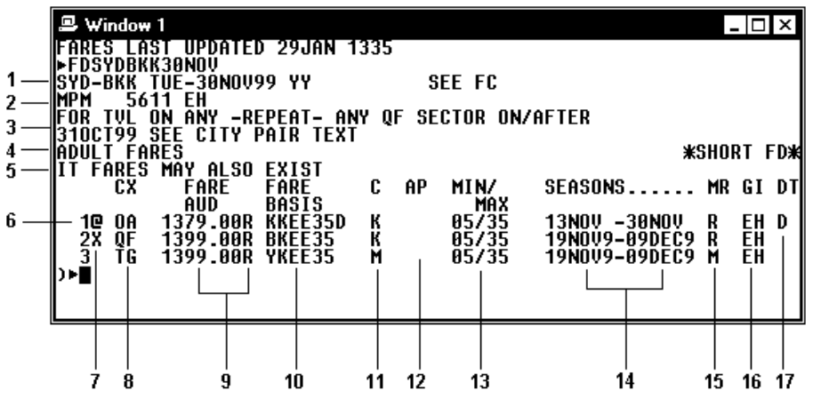
1.4 Identify the functions of an automated information system
Fare reservation
Notes:
Image from TM. Discuss as necessary

Slide 15
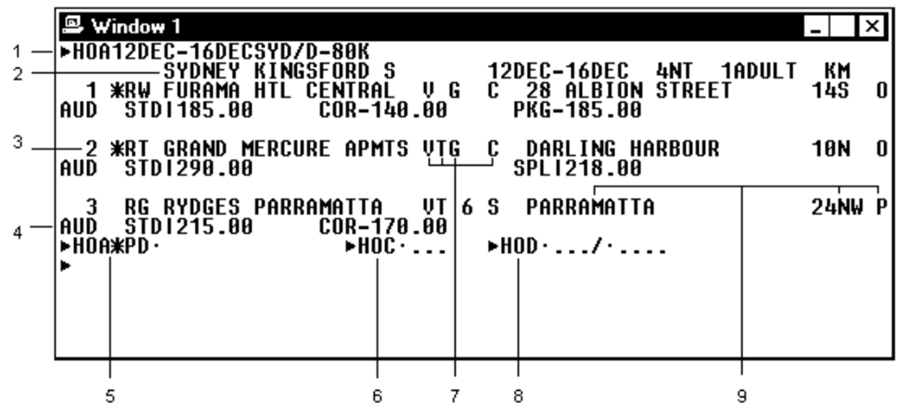
1.4 Identify the functions of an automated information system
Hotel reservation
Notes:
Image from TM. Discuss as necessary

Slide 16
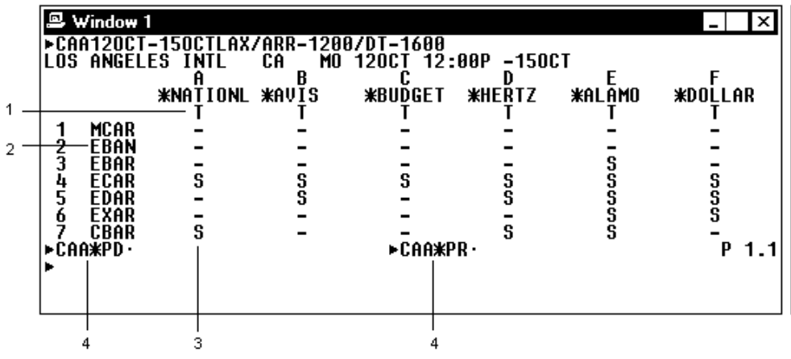
1.4 Identify the functions of an automated information system
Car reservation
Notes:
Image from TM. Discuss as necessary

Slide 17

1.4 Identify the functions of an automated information system
Internet
The World Wide Web is a collection of electronic documents that are linked together like a spider web
These documents are stored on computers called servers located around the world
Notes:
Take time to review the index of the Galileo training handbook as this indicates the functions of the system.
Ensure trainees understand all terminology used
Review the pages in the TM which indicate how information is displayed including hotel and car reservations
Discuss these pages as necessary.

Slide 18

1.4 Identify the functions of an automated information system
Notes:
A simple visual image of how it all works.

Slide 19

1.4 Identify the functions of an automated information system
The Web consists of:
Your personal computer
Web browser software to access the Web
A connection to the Internet Service provider (ISP)
Servers to host the data
Routers and switches to direct the flow of data
Notes:
Ensure trainees are familiar with terminology

Slide 20
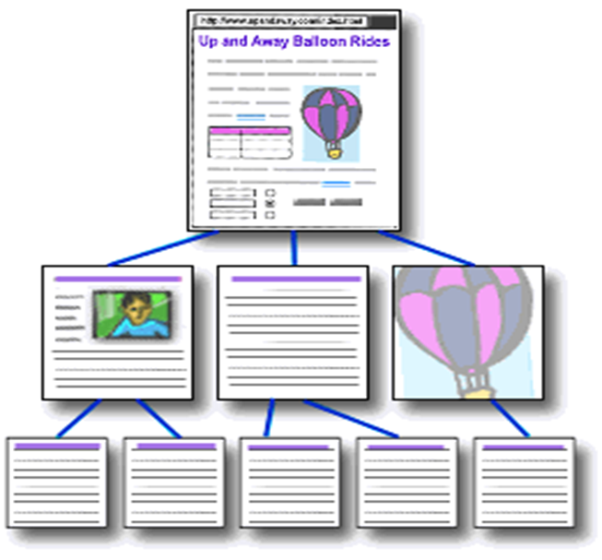
1.4 Identify the functions of an automated information system
A website is one or more
web pages that relate to a
common theme, such as a
person, business, organization, or a subject, such as sports.
The first page is called the home page, which acts like an index, indicating the content on the site.
Notes:
Ensure trainees are familiar with terminology

Slide 21

1.4 Identify the functions of an automated information system
A web page is an electronic document written in a computer language called HTML (Hypertext Markup Language).
Web pages can contain text, graphics, video and sound, as well as interactive features, such as data entry forms.
Each page has a unique address known as a URL (Uniform Resource Locator), which identifies its location on the server.
Notes:
Discuss as necessary. Bring attention to terminology

Slide 22

1.4 Identify the functions of an automated information system
Web pages are stored on web servers located around the globe
Entering the (Uniform Resource Locator) URL address of a web page in your web browser or clicking a link sends a request to the server which hosts the page.
The server sends the web page to your computer and your web browser displays it on your screen
Notes:
Discuss as necessary

Slide 23
1.4 Identify the functions of an automated information system
Internet allows users to:
Connect easily through personal computers and other devices
Exchange electronic mail (E-mail) worldwide, nearly instantaneously
Access, review and create information
Access multimedia information that includes sound, photos & video
Access diverse perspectives from around the world
Notes:
Lead a class discussion on student’s use of the internet in their personal lives; then take the discussion to their professional lives

Slide 24
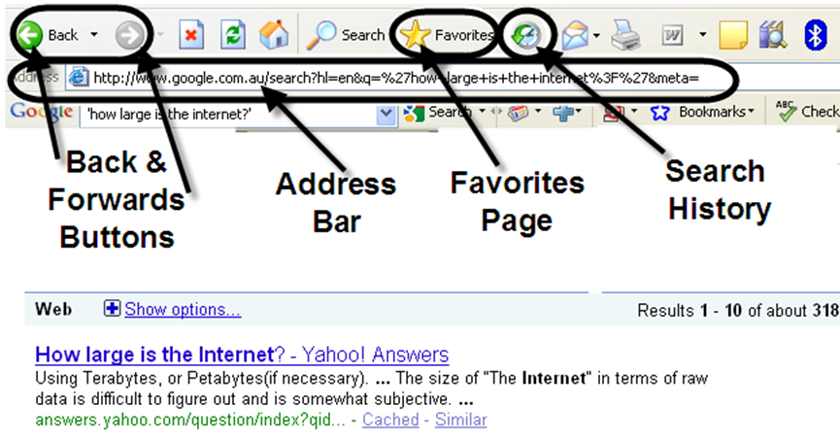
1.4 Identify the functions of an automated information system
Internet explorer
Notes:
It is likely most trainees will be familiar with this content. If so, use this opportunity to have them explain their understanding.
Ensure everyone understands these functions as computer skills can vary greatly

Slide 25
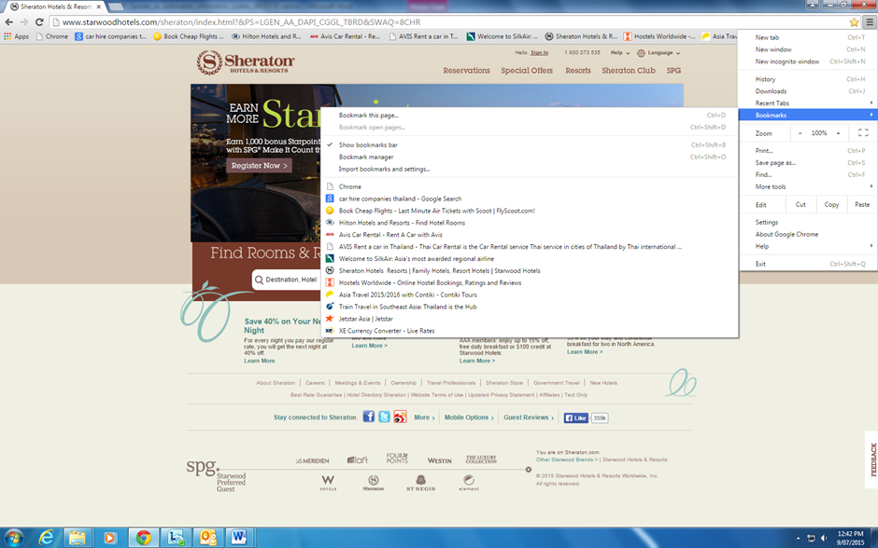
1.4 Identify the functions of an automated information system
Google Chrome bookmarks
Notes:
Discuss as needed. Compare against program in use in your workplace or study area

Slide 26
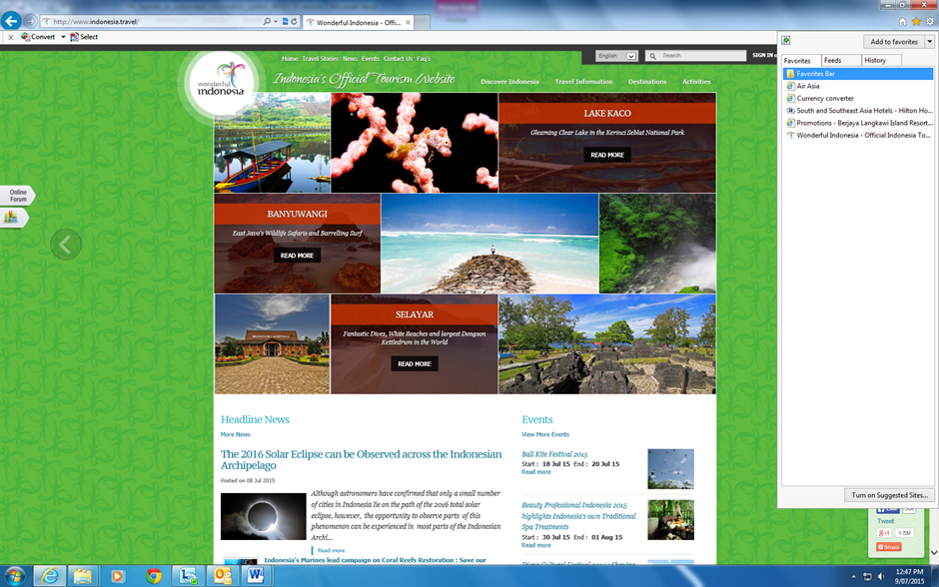
1.4 Identify the functions of an automated information system
Internet explorer bookmarks
Notes:
Discuss as needed. Compare against program in use in your workplace or study area

Slide 27

1.4 Identify the functions of an automated information system
Search engines
Hyperlinks
http://www.angliss.edu.au/
Notes:
Access this web page will take you to the image displayed in the TM in order to demonstrate the hyperlinks. Many trainees will already be familiar with this function
Complete Activity 5

Slide 28

1.4 Identify the functions of an automated information system
My computer
File folders
Files
File naming
Minimise, restore and close windows
Typing tips
Notes:
Again, it is likely trainees will be familiar with this content however take time to ensure no one is left behind.
After reviewing the information ask trainees (even if they thought they knew it all) if they were able to learn one new thing they didn’t know before, no matter how small
Ensure all work projects have been completed and handed into trainer ensuring cover page details are attached for assessment tracking.
Review the summary page for Element 1 to confirm what has been completed for this element.

Slide 29
Element 2: Access information using an automated information system
2.1 Identify information requirements
2.2 Identify and select appropriate sources of information
2.3 Apply search techniques to locate identified information
2.4 Interrogate the system to secure full range of information available on the system
2.5 Verify captured information meets identified need
Notes:
Introduce the five performance criteria which make up Element 2

Slide 30

2.1 Identify information requirements
The information requirements of your customer will depend on a range of different factors
The types of information you may need to investigate may include:
Pricing of products and services
Availability
General destination information
Product information:
Accommodation
Transport
Attractions
Amenities
Events and festivals
Notes:
Can trainees add anything more to this list?
Refer to the example in the TM of differing client needs

Slide 31

2.1 Identify information requirements
Asking questions and taking notes helps you to get a clear picture of what your client needs:
Ask questions
Qualifying customer wants
Sales skills
Types of questions
Continue qualifying
Notes:
Take time to discuss customer service skills.
Refer to the example for consideration in TM
Each client is different
Discuss sales skills required when dealing with initial enquiries and clarifying wants and needs. Types of questions to use.
Provide examples of how to phrase questions to obtain more in-depth answers
Importance of continuing to qualify client wants and needs to gain their satisfaction.
Role play in pairs or small groups a client enquiry and practice asking suitable questions to qualify client preference and offer suitable recommendation
Complete Activity 6

Slide 32

2.3 Apply search techniques to locate identified information
you will need to make a decision on where to start looking:
Computer Reservation System
A ‘preferred’ supplier
A search engine – Google, Yahoo
Notes:
Share your experience with trainees on how to best approach enquiries and which search methods might be a best first approach. Ask trainees to share any experience they may have.
Enquire if trainees have a preferred search engine and why it is so.
Review the 5 most poplar search engines in TM
Review making an enquiry in a search engine and the results presented. If you have access to the internet conduct a different enquiry for the group and interpret the results page for them
Answer any questions trainees may have about this before asking them to
Complete Activity 7

Slide 33
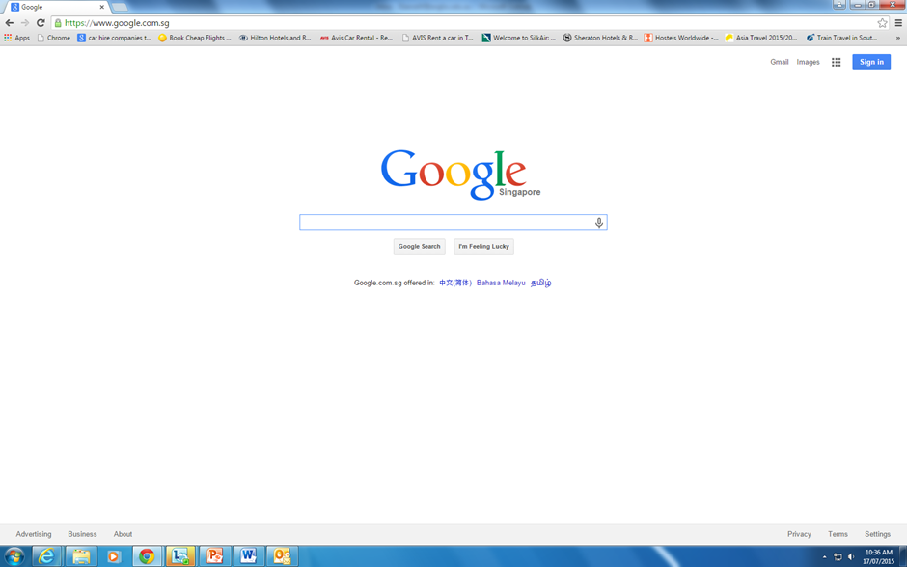

2.3 Apply search techniques to locate identified information
Search engine - Google
Notes:
Discuss as needed. Select images as needed.

Slide 34
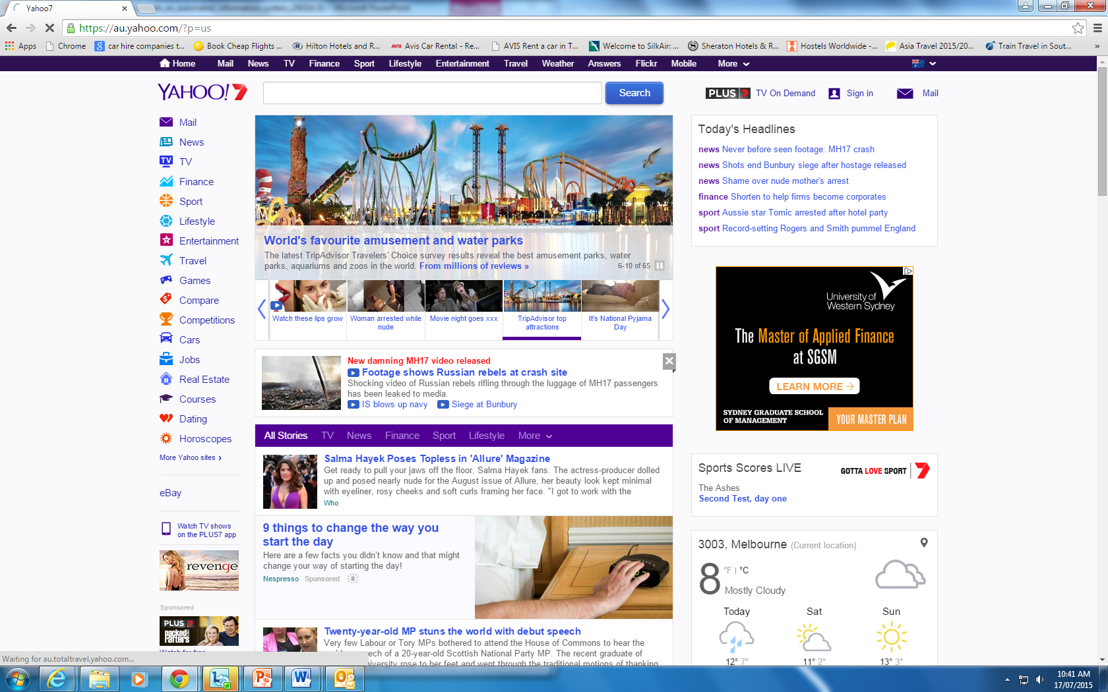
2.3 Apply search techniques to locate identified information
Search engine - Yahoo
Notes:
If access to internet is available, enter a search topic to demonstrate how to access web pages and images

Slide 35
2.3 Apply search techniques to locate identified information
Key words and phrases
Use the words likely to appear on the pages you want; i.e.—Singapore Car Hire; Brunei cheap hotels
Avoid using a question as a query. For example, the query ‘Does Hanoi have a Hilton Hotel’ instructs the search engine to find all these words. Such a query won’t necessarily find pages answering your question. A better, or more effective, query may be ‘Hanoi Hilton Hotel’
When a search engine registers common words such as ‘where’, ‘do’, ‘I’, ‘for’ and ‘a’ it ignores them so that the engine can return more targeted results
Notes:
Share your experience with trainees on phrasing enquiries and discuss further as needed

Slide 36
2.3 Apply search techniques to locate identified information
Key words and phrases continued
Does your query have enough specific terms; i.e. ‘Hanoi’, ‘Hanoi Hotels’, or ‘Hanoi Cheap Hotels’
If you are searching for something that returns many different types of results, you should add a word that distinguishes them
For best results, use a few specific words. For example, ‘Cheap Hanoi Hotels’ will return a better result than ‘List of Cheapest Hanoi Hotels with Swimming Pools’
Search engines will usually recognise any spelling mistakes and suggest a more common spelling quickly
Notes:
Continued from previous slide.
Ask trainees to consider their search enquiry phrase or key words for Activity 8. Provide a time allowance for completion
Complete Activity 8. Once completed randomly ask for answers to each question. Did anyone approach the question differently? Which search engine was used?

Slide 37
2.3 Apply search techniques to locate identified information
Refining a query
You are looking for information on car hire in Thailand for a corporate client who needs a limousine service. You could enter ‘Thailand Car Hire’, but many results will come back referring to general Thailand car hire
You would need to refine your entry by putting in ‘Thailand Car Hire Limousine Service’ as the search description in order to get the level of detail you want
Notes:
Discuss the example from the TM listed here.
Brainstorm suggestions for Activity 9. You may choose to provide more examples to highlight how you can refine queries to be time efficient.
Have trainees complete Activity 9

Slide 38










2.3 Apply search techniques to locate identified information
Social media platforms
Notes:
Enquire how many trademarks are recognised, how many used by trainee.
Work through each of the social media platforms discussing pro’s and cons of each.
Trainees will be able to offer personal opinion and experience here.
Complete Activity 10

Slide 39

2.4 Interrogate the system to secure full range of information available on the system
The internet
The internet is a valuable automated information tool
The internet will return a great deal of information to you
From all the information you find or purchase, you can then select, download and organise what is most relevant to the customer’s query and requirements
Notes:
Discuss as necessary, focusing on how to find your way through the maze of information to what is most suitable to you for your client.

Slide 40
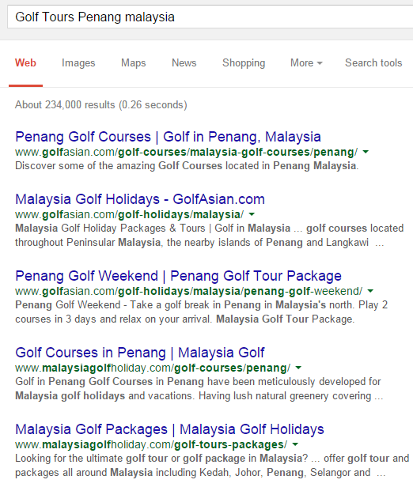
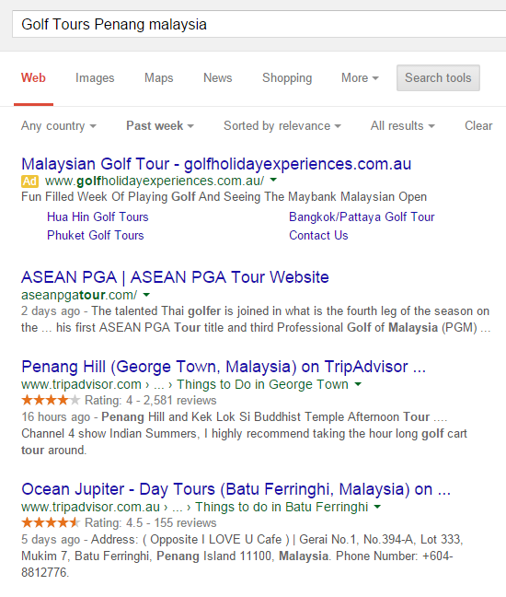
2.4 Interrogate the system to secure full range of information available on the system
Notes:
This slide demonstrates search tools. Use the next slide to show drop boxes within Search Tools options
Discuss further as necessary.
If access to the internet conduct a different search and discuss as a group how to organise the returned content before asking trainees to complete Activity 11
Complete Activity 11

Slide 41
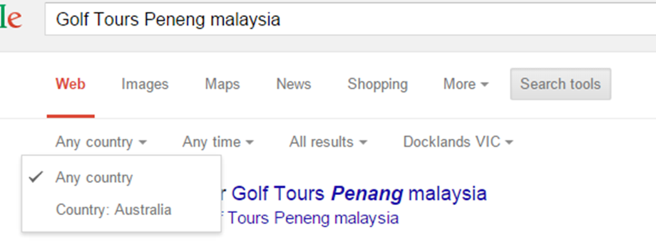
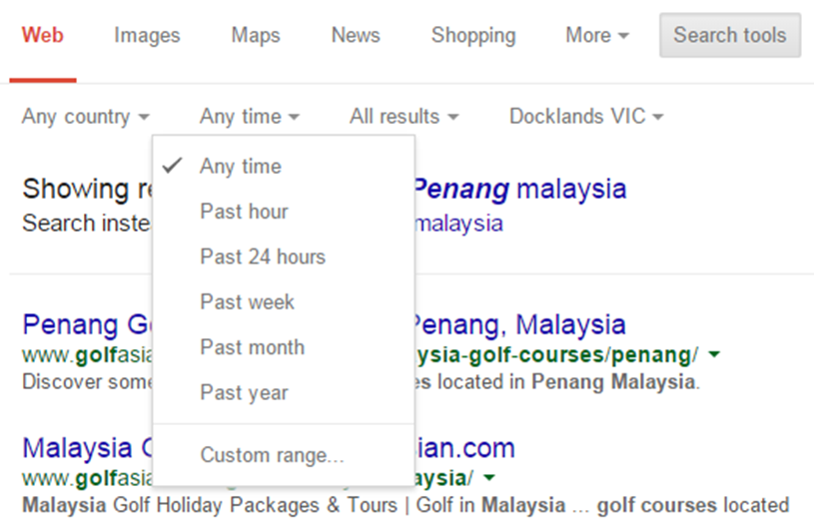
2.4 Interrogate the system to secure full range of information available on the system
Notes:
Links to previous slide.
Now discuss ‘conducting further search’
If access to internet a search can be conducted to demonstrate these tools for the group.
Follow TM and discuss and explain the advanced search functions
Complete Activity 12

Slide 42
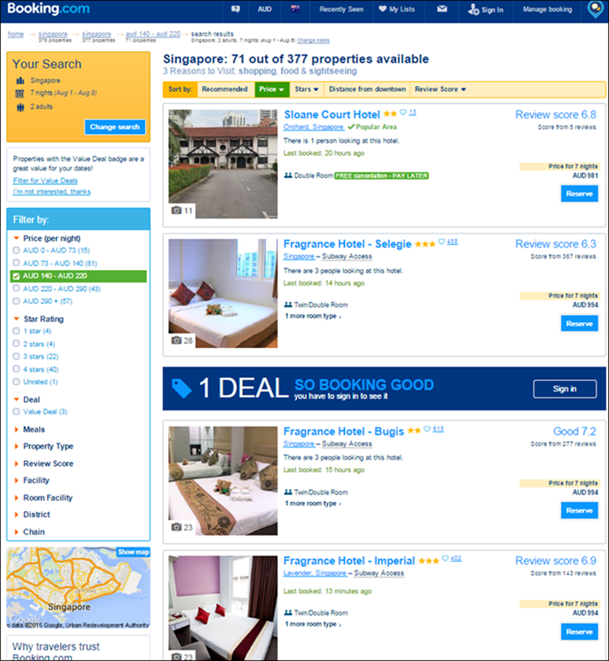
2.4 Interrogate the system to secure full range of information available on the system
Available information
Displaying information:
By star rating
By price
By location (distance)
By deal
Notes:
Working from the TM discuss the information displayed on this web page (which is from the TM)
If access to internet, bring up the site and navigate it for the group showing the different information able to be sourced.
Demonstrate the ‘Back’ and ‘refresh’ buttons, hyperlinks and opening additional tabs
Answer any questions trainees have.
Complete Activity 13 – provide a time allowance and have trainees present back to the group. Discuss search methods and findings.

Slide 43

2.5 Verify captured information meets identified need
Once you have decided what information you need to provide to your customer, you need to ensure the scope and depth are appropriate:
It is up to your discretion to decide how much information you need to provide
You need to consider your customer needs but also it will depend on what your job role is
Notes:
Discuss varying job roles from travel agencies to visitor information centres – small and large. How much would you need to know in a particular role?
Discuss Activity 14
Wealthy couple/on a budget
Retired/on holiday
Easy going/very particular on preference
Experienced golfers?
Complete Activity 14
Ensure all work projects have been completed and handed into trainer ensuring cover page details are attached for assessment tracking.
Review the summary page for Element 2 to confirm what has been completed for this element.

Slide 44

Element 3: Obtain information using an automated information system
3.1 Enable access to required system and/or information
3.2 Select required information
3.3 Download information
3.4 Print information
Notes:
Trainer introduces the performance criteria which make up Element 3

Slide 45
3.1 Enable access to required system and/or information
Information purchased for your organisation
Making purchases for your clients
purchasing online varies depending on a number of factors including:
The system you are using
The product or service you are purchasing
The availability of the product or service
Security and automated purchasing
Notes:
Share your experience on the most common purchases made.
Discuss purchasing processes and protocols.
Using a CRS
Using a wholesaler
Booking tours and cruises
Hotel booking
Car hire booking
Quote or receipts for payment
Discuss security when purchasing online.
If access to the internet search a hotel or airline website and demonstrate the various screens to the payment page

Slide 46
3.1 Enable access to required system and/or information
Points to remember when purchasing online:
Double check pricing
Find and read the privacy policy.
Review the return, refund, and shipping and handling policies as well as the other legal terms
Print the terms
Make sure the internet connection is secure
Use the safest on-line payment method
Notes:
Discuss as necessary adding any personal knowledge or experience of things that may have gone wrong.
Ensure all trainees are familiar with the security icons to look for when making payment online.

Slide 47

3.1 Enable access to required system and/or information
Type of information sites:
Bookmarking sites
Social news
Media sharing
Micro-blogging
Blog comments and forums
Notes:
Work through each of the types of information sites seeking any knowledge or experience trainees have in these fields.
Include the CRS as one of the information systems
Complete Activity 15

Slide 48

3.2 Select required information
Consider the reliability and reputation of the information source
Preferred suppliers
Best option data
Notes:
This performance criteria revisits material already covered and the opportunity can be taken to have trainees share their new knowledge on what process they would follow.
Complete Activity 16 – (you may wish to indicate different ages for the children in the scenario to different trainees in order to vary the information returned)

Slide 49
3.3 Download information
What is your company policy on this?
When downloading, you should always check the size of the files and estimate the time required to download them
Does your enterprise have broadband or wireless access - relatively fast downloading?
or dial up access - relatively slow downloading
Are there any copyright issues?
Notes:
Break class into smaller groups and have groups work through these questions from their knowledge of their workplaces. Each group then to present on their responses

Slide 50
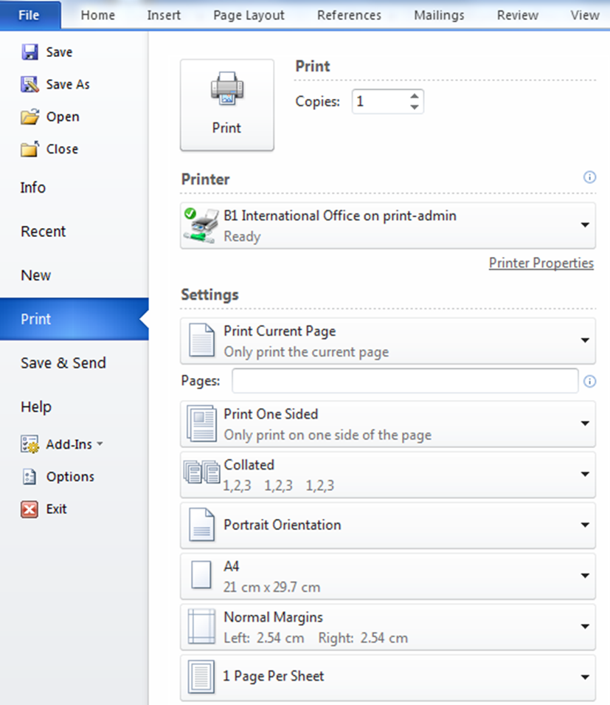
3.4 Print information
Selected the correct printer
Black and white or colour copy
Which page numbers
Portrait or landscape printing
Single or double sided
Notes:
Explain the printing page and emphasise the areas where people generally make silly mistakes
Too many copies
Wrong page numbers
Not printing a sample copy
Printing in colour when not necessary
Not doing a print preview

Slide 51
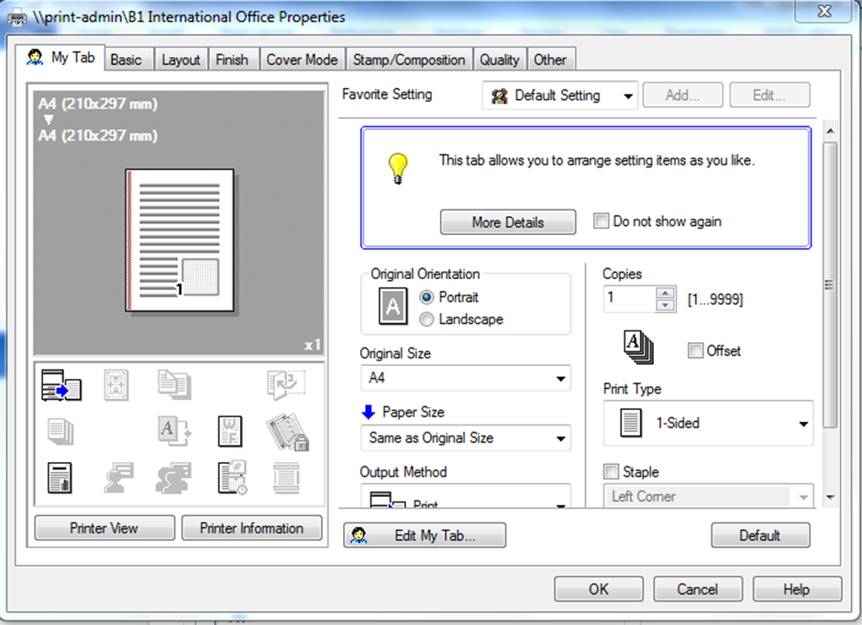
3.4 Print information
Printer properties
Notes:
Explain various basic uses from this page.
Always review you have selected all the correct choices before activating large print jobs.
Have samples available for trainees to view.
Double sided
Two pages on one page (2in1)
Stapled – top corner, two on left side
Hole punched and stapled
Water marking
Complete Activity 17
Ensure all work projects have been completed and handed into trainer ensuring cover page details are attached for assessment tracking.
Review the summary page for Element 3 to confirm what has been completed for this element.

Slide 52

Element 4: Use information from information an automated information system
4.1 Forward information as required
4.2 Save identified information
4.3 Manipulate accessed information
4.4 Report on findings
Notes:
Trainer to introduce the performance criteria which make up Element 4

Slide 53
4.1 Forward information as required
There may be times where you decide to send information to your client via email
Include a clear explanation of why you are forwarding the information
If forwarding information to several people, use the Bcc function
Keep notes of the information you are giving to clients so that it can be easily retrieved in the future
Notes:
Discuss as needed taking into consideration requirements required for Activity 18.
Complete Activity 18

Slide 54
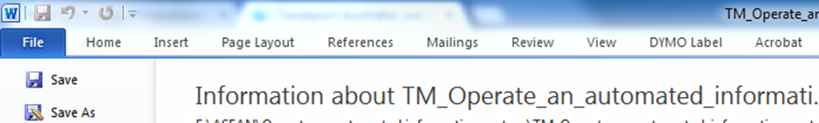
4.2 Save identified information
Information you have conducted searches for
Documents you have created or altered
Consider company policies, IP and copyright
Downloading and saving software
Notes:
Explain why you need to consider company policy, Intellectual property and copyright
Discuss as needed paying attention to the importance of clicking ‘save’ on software that is downloaded (and approved by management to do so). It is important to save material to suitable locations so maintain order to your filing systems.

Slide 55
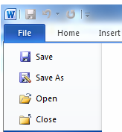
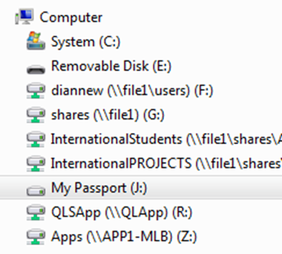
4.2 Save identified information
Saving files in Word
Notes:
It is likely trainees will be familiar with these procedures however take time to explain correct procedures to anyone who may be new to the information
In this example ‘my passport’ is an external hard drive and the removable disk is of course a USB stick (thumb drive).
Auto save is useful as a backup but don’t rely on it!
Again emphasise the importance of labeling and saving files to correct locations. It doesn’t take long for your computer to become a filing mess because you thought you would fix it later.
Complete Activity 19

Slide 56
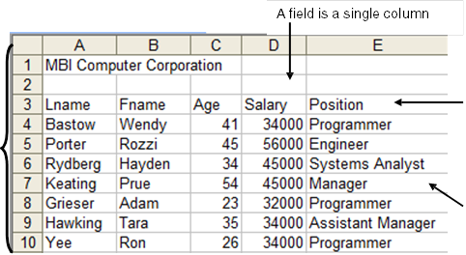
4.3 Manipulate accessed information
Body Copy:
Customer databases:
Organising Data
Column labels are field names
A record is a single row in the list
Notes:
Ideally this training should be conducted in a computer room or an area where trainees can work into a computer or personal laptop.
Some trainees may be familiar with Excel already. If this is the case ask them to assist someone who is new to the program.

Slide 57
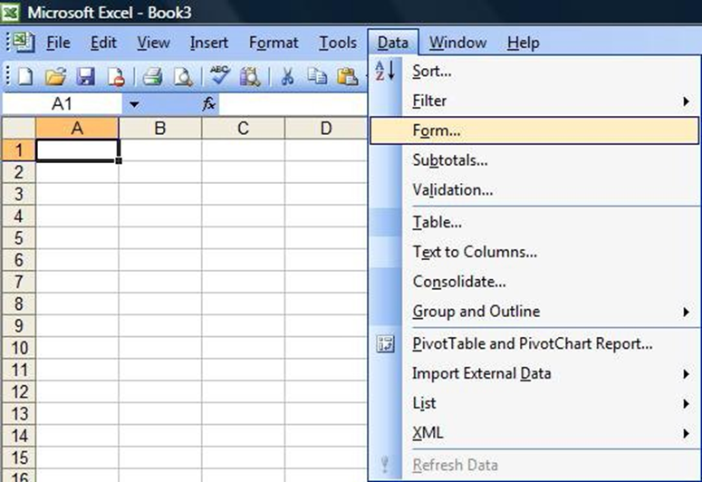
4.3 Manipulate accessed information
To open a data form:
Click A3 to select it
Choose the Data menu, then the Form command.
Remember if the Form command is not visible, you may have to click .., to display all the commands under this menu.
Notes:
Trainer to lead students through the process, or ask an experienced student to do so

Slide 58
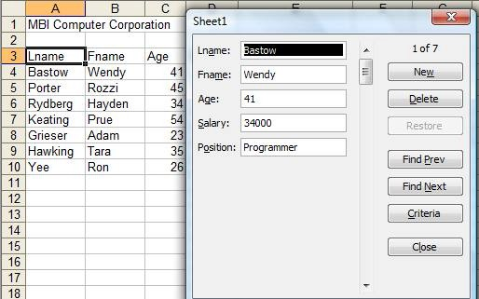
4.3 Manipulate accessed information
A data form appears displaying the first record in the database.
Notes:
Record Number Indicator
A data form can display up to 32 fields.
The record number indicator is displayed in the upper right-hand corner of the data form. This indicates which record is being displayed and how many records are in the database.
Explain the command tabs as listed in the TM

Slide 59

4.3 Manipulate accessed information
Using a data form to edit records
To change the Age field of the displayed record from 41 to 42:
Click: worksheet
Type: 42 to alter the Age
Using a data form to add records
You may add records to the database by clicking the button in the data form
Notes:
Follow the exercise in the TM explaining each step to trainees

Slide 60

4.3 Manipulate accessed information
Using a data form to find records
Sorting on one field
Sorting on multiple fields
Notes:
Using your laptop and data projector display an excel spread sheet for the group and demonstrate each of the above listed steps. If trainees have access to computers or laptops have them work through each step with you.

Slide 61
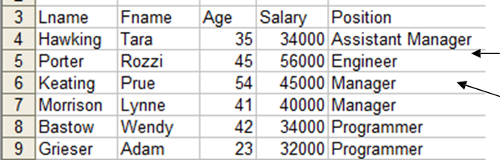
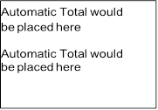
4.3 Manipulate accessed information
Automatic subtotals
Notes:
Work through automatic subtotals and subsequent steps as listed in TM. Allow trainees to follow each step on the computer screen having time for questions along the way. Ensure everyone is at the same point of progression.
Have trainees save their work to a USB.
Complete Activity 20

Slide 62

4.4 Report on findings
Making recommendations:
To colleagues
To management
To clients
Notes:
Have discussion on the various types of reporting that may be required in the workplace.
Most common is likely to be to clients.
Explain how to create sequence and structure so the client is not lost along the way.
Have a copy of the report for the client to follow and make any notes on as explanation is conducted.
Complete Activity 21
Ensure all work projects have been completed and handed into trainer ensuring cover page details are attached for assessment tracking.
Review the summary page for Element 4 to confirm what has been completed for this element.

Slide 63

Element 5: Up-date and maintain information on an automated information system
5.1 Enter data onto automated information system
5.2 Save and back-up data
Notes:
Trainer to introduce the performance criteria which make up Element 5

Slide 64
5.1 Enter data onto automated information system
You will be required to open, generate and amend data, according to task and organisational requirements:
Update and maintain information:
Retrieve, view and close a word document;
Create, save and print a word processing document
Retrieve, amend, save and print a word document
Notes:
It is likely trainees will know how to complete these tasks. Confirm this as fact before moving on.

Slide 65
5.1 Enter data onto automated information system
Directories, sub directories and folders
Records and fields
Log-in/log-out protocols
Proofreading
Spellcheck and thesaurus
Accessing recent records
Deleting files
Menus and prompts
Default settings
Error correction
Keying techniques
Screen sizing
Copying to thumbdrive / pendrive / USB
Fonts and font size
Notes:
The previous slide contained relatively basic skills there is likely to be one or more skill identified here that not all trainees are familiar with.
Take time to identify where each of these tools are located on the tool bar and how to use them.

Slide 66
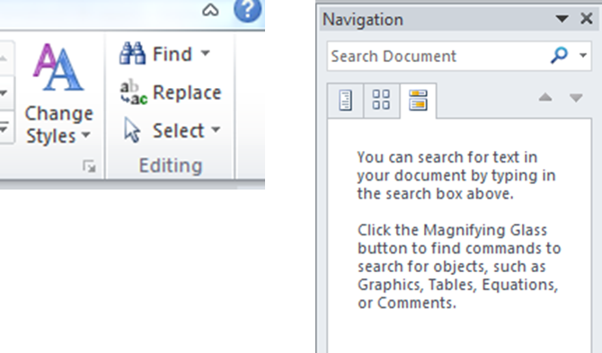
5.1 Enter data onto automated information system
Locating data
Notes:
Demonstrate how to conduct a ‘Find’ search.
Click on “Find’ and enter a phrase or key words in the search bar to demonstrate that it will take you to a particular part of a document.

Slide 67
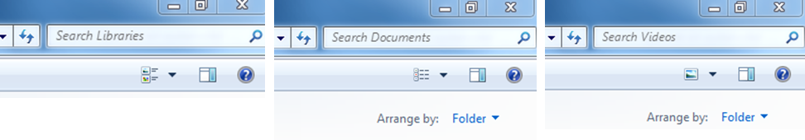
5.1 Enter data onto automated information system
Locating data
Notes:
Demonstrate searching for documents.
Have something prepared that you can suitably demonstrate on your own folders or computer.
Activity 22 should have been completed already

Slide 68

5.1 Enter data onto automated information system
Save, close and backup data
Storing reference information:
on hard drives
on USB/thumb drives
on networked computers
Archiving
Notes:
Have discussion on where trainees save files to.
Any trainees who have work experience? – what is or was the company policy in this area?
Who backs up their work?
Des anyone keep a hard copy as backup?
Who has lost files due to computer crashing, virus, fire or other problem?
Have discussion on archiving and the importance of this being conducted to company standards.
Discuss the common ways of archiving and associated business/tax law for your country.
Complete Activity 23 – ensure trainees understand requirements. Demonstrate how to do a screen shot if needed.
Ensure all work projects have been completed and handed into trainer ensuring cover page details are attached for assessment tracking.
Review the summary page for Element 5 to confirm what has been completed for this element.

Slide 69
The End
This unit comprised five Elements:
1. Identify the context for use of an automated information system
2. Access information using an automated information system
3. Obtain information using an automated information system
4. Use information from information an automated information system
5. Up-date and maintain information on an automated information system
You have now completed this unit and the trainer will provide details on assessment.
Good Luck
Notes:
Trainer advises learners on what assessment is required and how it is to be conducted.

